Slide 1
Introduction to Multimedia ICT 1210
Wiraj Wickramaarachchi
Department of ICT
Faculty of Technology
Rajarata University of Sri Lanka

Slide 2
Course Details
Course Aim :
To enhance the knowledge of processing and communication of information in various forms.
Course ILOs : At the end of the course, the student should be able to
Formulate a working definition of interactive multimedia
Describe different multimedia processing techniques and discuss their advantages and disadvantages
Demonstrate the use of text, animation, digitized sound, video control, and scanned images
Design and implement multimedia content by applying current multimedia technologies

Slide 3


References
Fundamentals of Multimedia (Second Edition)
by Ze-Nian Li, Mark S. Drew, and Jiangchuan Liu. (DOI: 10.1007/978-3-319-05290-8) Springer International Publishing
Multimedia
by Er. Rachit Grag published by S.K. Kataria & Sons Publications

Slide 4




Course Outline
Font design – Birdfont
Image Editing – Adobe Photoshop
Audio Editing – Adobe Audition
Video Editing – Adobe Premier
Introduction to Multimedia
Fundamentals of Multimedia
Text (font) design
Graphics/ Image Data Representations
Color in Image and Video
Fundamental Concepts in Video
Basics of Digital Audio
Multimedia Data Compression
Multimedia Communications

Slide 5
Assessment Strategy
10%
10%
Quizzes/Tutorial
10%
Image and Graphic design and Editing (Individual)
Text (font) Design Project (Group)
20%
40%
Multimedia Project (Group)
End semester examination (Theory)
10%
Assignments (Individual)

Slide 6
Penalties for the late submission
Late within ONE week after the deadline: 5 marks deduction from earned total
Late between ONE to TWO weeks after the deadline: 10 marks deduction from earned total
Late between TWO to THREE weeks after the deadline: 15 marks deduction from earned total
Late between THREE to FOUR weeks after the deadline: 20 marks deduction from earned total
Late after ONE month from the deadline: NO marks will be given to the assignment submission
Late submissions for in-class quizzes will NOT be accepted
*Note that the above marks are based on a scale of 0-100

Slide 7
Introduction to Multimedia

Slide 8
Lesson Outline
Multimedia: Past and Present
The term “MULTIMEDIA”
Multimedia vs. Interactive Media vs. Hypermedia
Multimedia System
Application of Multimedia
Multimedia Hardware
Multimedia Team

Slide 9
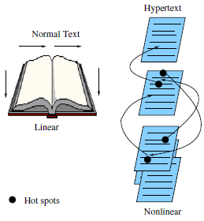
Multimedia: Past and Present
The use of multimedia to communicate ideas might begin with newspapers, which were perhaps the first mass communication medium, using text, graphics, and images.
Before still-image camera was invented, these graphics and images were generally hand-drawn.
Joseph Nicéphore Niépce captured the first natural image from his window in 1826 using a sliding wooden box camera.
Hypermedia, WWW, Internet, HTML and XML have influenced extremely to the development of multimedia.

Slide 10
Multimedia: Past and Present
The fast evolution toward a new generation of social, mobile, and cloud computing have influenced multimedia processing and sharing.
The users are now actively engaged to be part of a social ecosystem, rather than passively receiving media content.
The revolution is being driven further by the deep penetration of 3G/4G wireless networks and smart mobile devices.
Notes:
Entering the new millennium, we have witnessed the fast evolution toward a new generation of social, mobile, and cloud computing for multimedia processing and sharing. Today, the role of the Internet itself has evolved from the original use as a communication tool to provide easier and faster sharing of an infinite supply of information, and the multimedia content itself has also been greatly enriched. High-definition videos and even 3D/multiview videos can be readily captured and browsed by personal computing devices, and conveniently stored and processed with remote cloud resources. More importantly, the users are now actively engaged to be part of a social ecosystem, rather than passively receiving media content. The revolution is being driven further by the deep penetration of 3G/4G wireless networks and smart mobile devices. Coming with highly intuitive interfaces and exceptionally richer multimedia functionalities, they have been seamlessly integrated with online social networking for instant media content generation and sharing.
Please read the note on “Early history of multimedia’ for further information.

Slide 11

The term “MULTIMEDIA”
Applications that use multiple modalities to their advantage, including text, images, drawings, graphics, animation, video, sound (including speech), and, most likely, interactivity of some kind.
Graphics, visualization, HCI, computer vision, data compression, graph theory, networking, database systems—all have important contributions to make in multimedia at the present time.
Notes:
Multimedia is any combination of text, art, sound animation and video delivered to you by computer or other electronic or digitally manipulated means.
It is field concerned with the computer controlled integration of text, graphics, drawings, still and moving images (Video), animation, audio, and any other media where every type of information can be represented, stored, transmitted and processed digitally.
….

Slide 12
Multimedia vs. Interactive Media vs. Hypermedia
Non-Interactive / Traditional
Interactive / Hypermedia
Multimedia
Multimedia is the broad scope concept.
When a user interacts with multimedia (bidirectional communication), it becomes interactive media.
Traditional multimedia experience is more passive.
Non-sequential access among multimedia called as hypermedia.

Slide 13
Multimedia System
A system capable of processing multimedia data and applications
Synchronization |  | Tools and Application
 |  | Documents |  | Use Interface |  |  | Programing Abstractions
 |  | Database Systems |  | Operating Systems |  |  | Communication Systems
 |  | Computer Technology
 |  | Storage | Compression |  |  |  |  | Network
 |  |  | Sound |  | Image Graphics | Video Animation
Application Domain
System Domain
Device Domain
Notes:
Application Domain – provides functions to the users to develop and present multimedia projects. This includes software tools, and multimedia project development methodology.
System Domain – Including all supports for using functions of the device domain. (operating systems, Communication/ networking systems and DB Systems)
Device domain – basic concepts and skill for processing various multimedia elements and for handling physical device.

Slide 14




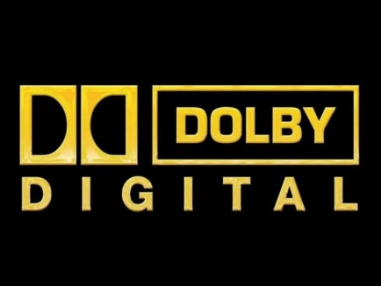
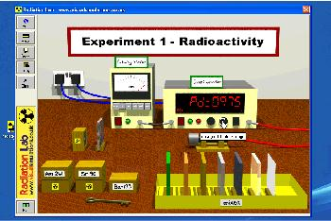
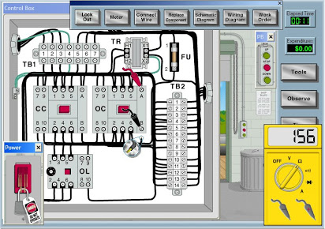

Application of Multimedia
Home entertainment
Computer games
Interactive encyclopedia
Story telling
Cartoons
Interactive television/ Cinema
Video-on demand
Educational purpose
Learning packages
Lab simulation

Slide 15

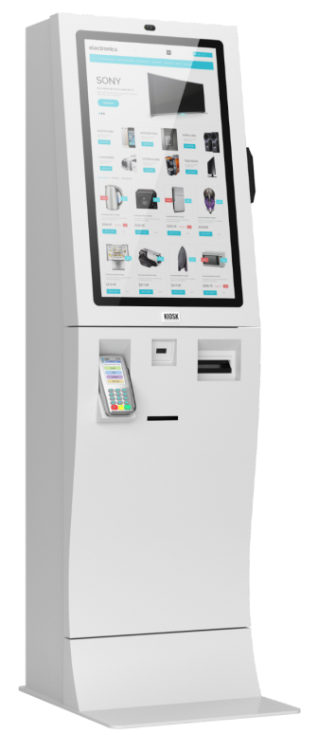
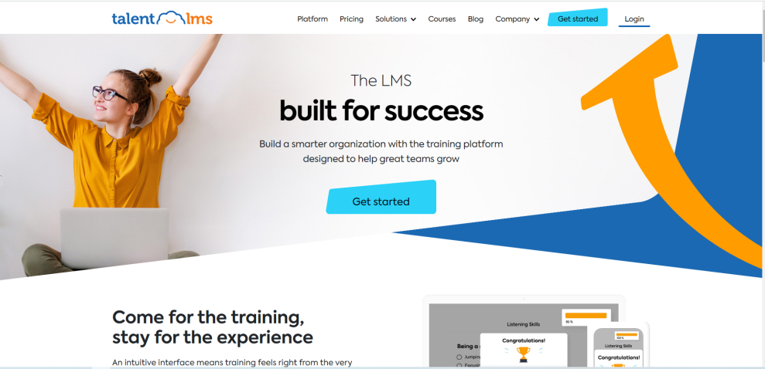


Application of Multimedia
Home shopping
Industrial training
Computer Based Training (CBT) Packages
Business/ E-Commerce
Marketing, Advertising
Product demonstrations, Presentations
Video conferencing
Kiosk

Slide 16
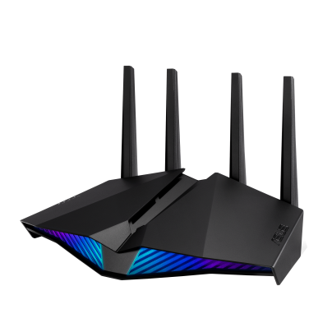
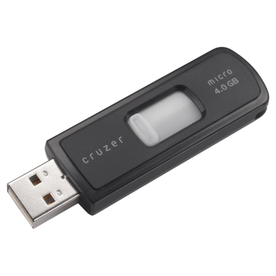
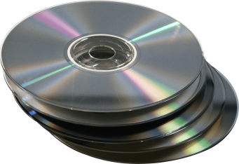
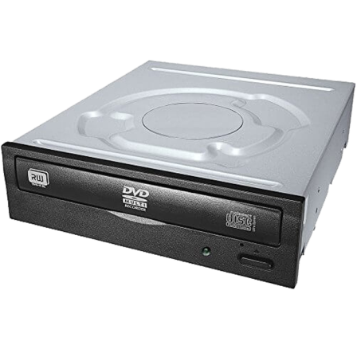
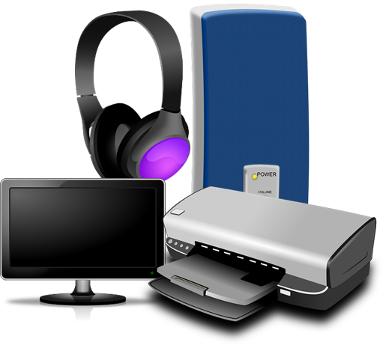
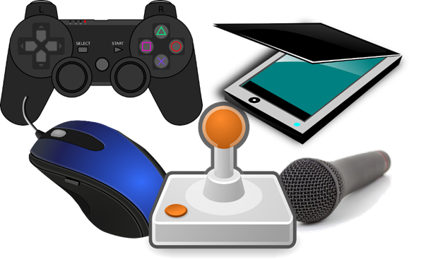
Multimedia Hardware
Monitor
Projector
Printer
Plotter
Amplifier and Speaker
Output
Input
Memory/ Storage
Communication
Keyboard
Mouse
Image Scanner
Microphone
Digital Camera
Hard Disk
Floppy Disk
Flash Drive
CD/DVD
Blue ray
Modem
DSL
ISDN
Multimedia Hardware

Slide 17

Multimedia Software Tools
Music sequencing and notation (Ex: Cakewalk Pro Audio, Finale, Sibelius)
Digital audio (Ex: Adobe Audition, Sound Forge, Pro Tools, Qbase)
Graphics and image editing (Ex: Adobe Illustrator, Adobe Photoshop, MS Paint, CorelDRAW)
Video editing (Ex: Adobe Premiere, CyberLink PowerDirector, Final Cut Pro, Adobe After Effects)
Animation (Ex: Multimedia APIs-Java3D, DirectX, OpenGL; Animation Software-Autodesk 3ds Max. Autodesk Softimage, Autodesk Maya)
Multimedia authoring (Ex: Adobe Flash, Adobe Director, Dreamweaver)
Text designing (Ex: FontLab, FontCreator, CorelDRAW)

Slide 18
Multimedia Project Life cycle
Initiation
Feasibility Study
Needs assessment & concept brief
Project plan
Management & Support plans
Feasibility study
Audience analysis
Functional specifications
Change Control Systems
Storyboard & flowcharts
Design
Interface design
Navigation maps
Sample screens
Storyboard & flowcharts
Production
Media acquisition
Media integration
Post production
Budget review
Final Revision
Test results
Implementation strategy
Summative evaluation
Delivery & Feedback
Release note/Documentation
Packaging
Product support
Client acceptance
Notes:
This is for both multimedia software development as well multimedia production.
We will discuss about multimedia production later on this lecture series.
Discuss an example of film production

Slide 19
Multimedia Team
Project Manager
Multimedia Designer
Interface Designer
Multimedia Programmer
Multimedia Content Writer
Video Specialist
Audio Specialist
Producer

Slide 20
Multimedia Team: Project Manager
Responsible for:
The overall development, implementation and day to day operation of the project.
The design and management of a project.
Understanding the strengths and limitations of hardware and software.
Ensuring people skill and organizational skills.
Conveying information between the team and the client.

Slide 21
Multimedia Team: Multimedia Designer
This team consists of:
Graphics designers, illustrators, animators and image processing specialists who deal with visuals, thereby making the project appealing and aesthetic.
Instructional designers, who make sure that the subject matter is presented clearly for the target audience.
Interface designers, who devise the navigational pathways and content maps.
Information designers, who structure content, determine user pathways and feedback and select presentation media.

Slide 22
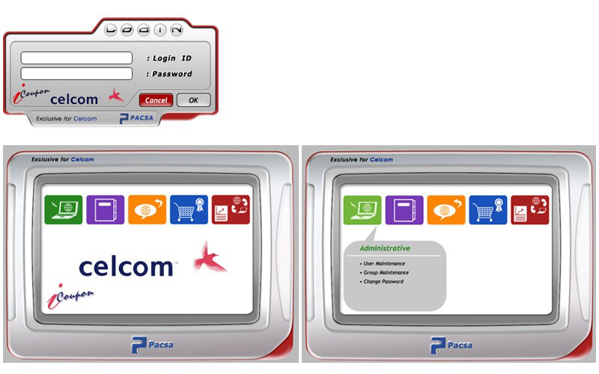
Multimedia Team: Interface Designer
responsible for :
Creating software device that organizes content, allows users to access or modify content and present that content on the screen.
Building a user friendly interface

Slide 23
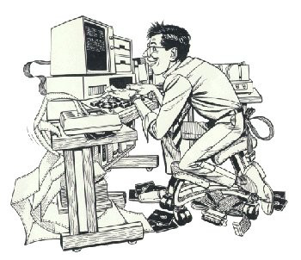
Multimedia Team: Multimedia Writer
Responsible for:
Creating characters, actions, point of view and interactivity.
Writing proposals and test screens.
Scripting voice-overs and actors narrations.

Slide 24
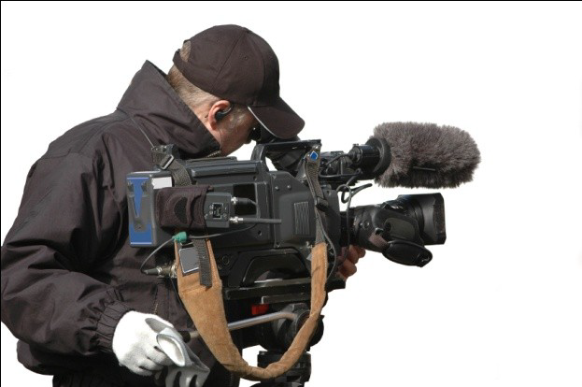
Multimedia Team: Video Specialist
Need to understand:
The delivery of video files on CD, DVD or the web.
How to shoot quality video.
How to transfer the video footage to a computer.
How to edit the footage down to a final product using digital nonlinear editing system (NLE)

Slide 25
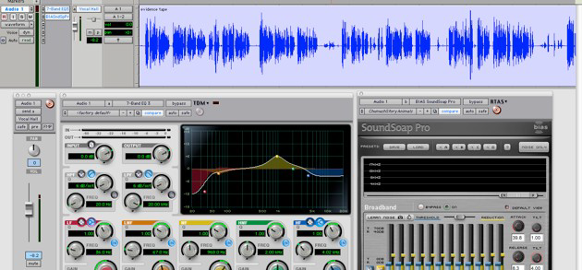
Multimedia Team: Audio Specialist
Responsible for:
Locating and selecting suitable music talent.
Scheduling recording sessions.
Digitizing and editing recorded material into computer files.

Slide 26
Multimedia Team: Multimedia Programmer
Also called Software Engineer
Integrates all the multimedia elements into a seamless project, using authoring systems or programming languages.
Writes codes for the display of multimedia elements and to control various peripheral devices.
Manage timings, transitions and record keeping.

